Slide 1

Ethics and Protecting Human Subjects
Trigger Warning:
Some images in this presentation depict immoral or unethical medical experiments [See Presentation without Pictures]
Notes:
1

Slide 2

Why are we talking about ethics?
… this is a class about UX Design and Human-computer Interaction…
… why are ethics important for our work?
… why do we need to talk about ethics in this class?
Notes:
2
Prompt the class, allow a discussion, let it flow freely, if possible:
What do ethics have to do with human-computer interaction, with design, with UX?
You will be working with people…collecting data…reporting on data etc.
That means…we conduct tests, field studies, interviews and observations with real users, children, adults, parents, etc.

Slide 3
Why are we talking about ethics?
… this is a class about UX Design and Human-computer Interaction…
… why are ethics important for our work?
… why do we need to talk about ethics in this class?
Because we work with People
Notes:
3
Prompt the class, allow a discussion, let it flow freely, if possible:
What do ethics have to do with human-computer interaction, with design, with UX?
You will be working with people…collecting data…reporting on data etc.
That means…we conduct tests, field studies, interviews and observations with real users, children, adults, parents, etc.

Slide 4
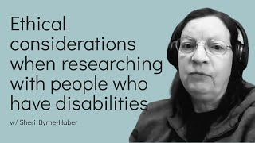
For example…
…when we work with people with disabilities (or diverse abilities)
Notes:
4
Prompt the class, allow a discussion, let it flow freely, if possible:
What do ethics have to do with human-computer interaction, with design, with UX?
You will be working with people…collecting data…reporting on data etc.
That means…we conduct tests, field studies, interviews and observations with real users, children, adults, parents, etc.

Slide 5

For example…
…when we work with minors or children or other vulnerable groups
Notes:
5
Prompt the class, allow a discussion, let it flow freely, if possible:
What do ethics have to do with human-computer interaction, with design, with UX?
You will be working with people…collecting data…reporting on data etc.
That means…we conduct tests, field studies, interviews and observations with real users, children, adults, parents, etc.

Slide 6
so what…where ethics ever an issue?
Question
Did we (researchers, experimenters ) ever mess up working with other people?
Notes:
6

Slide 7
so what…where ethics ever an issue?
Question
Did we (researchers, experimenters ) ever mess up working with other people?
Yes, we did mess up … a lot!
Notes:
7

Slide 8
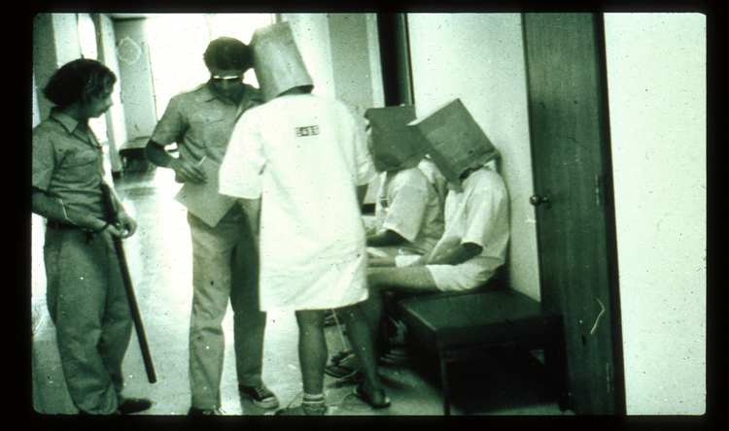
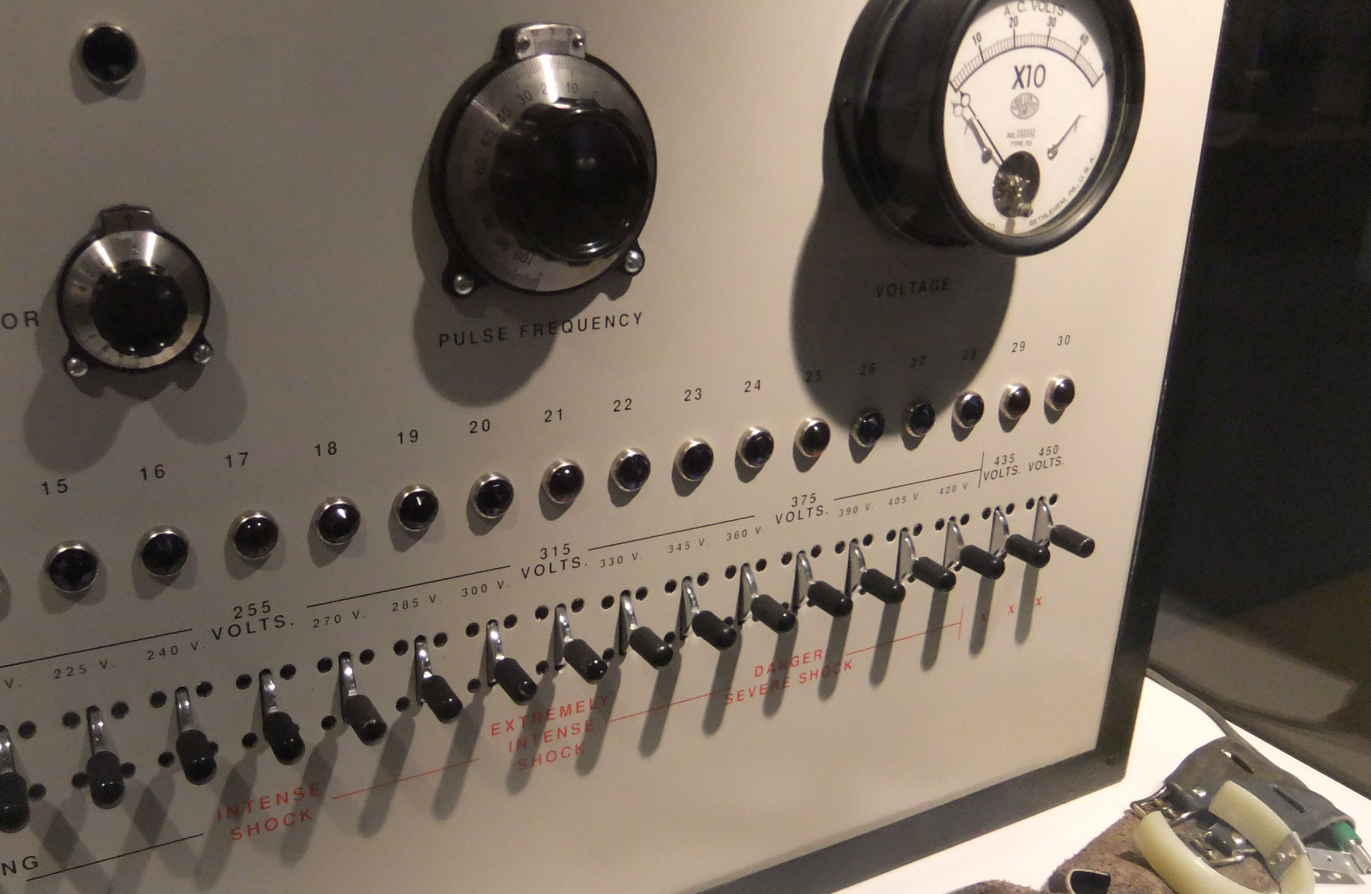
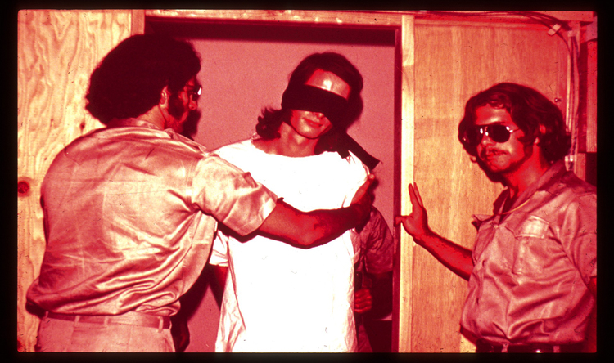
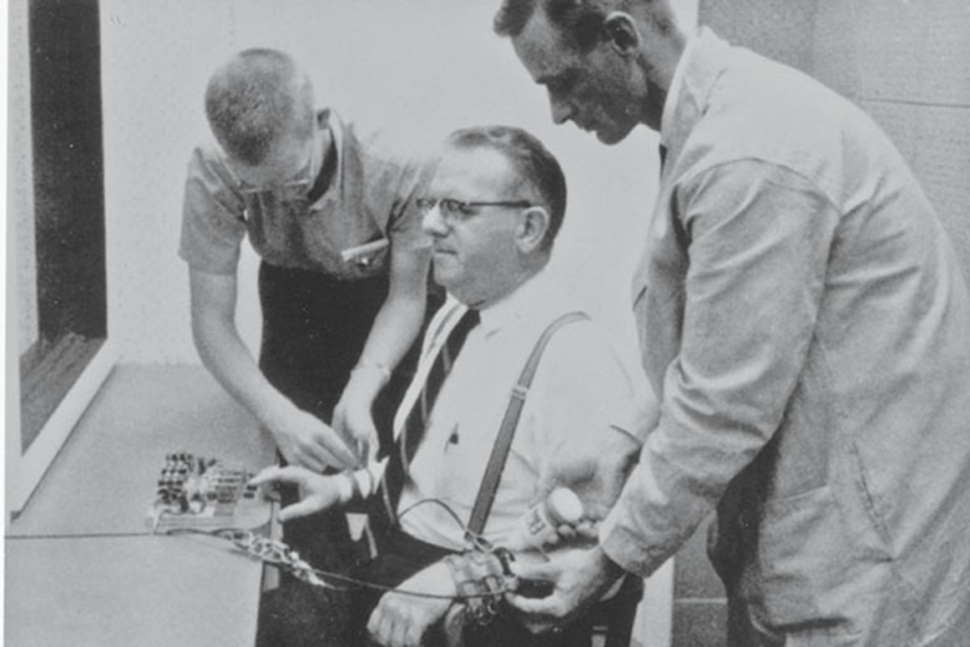
so what…where ethics ever an issue?
As a result, people were hurt both, psychologically and physically and suffered permanent and potential lethal outcomes.
https://www.verywellmind.com/thmb/8_od0SLmLGheZxR-oagtitSpqf8=/4000x3000/filters:fill(ABEAC3,1)/5727759849_685be7a535_o-56a793f05f9b58b7d0ebdb27.jpg https://psmag.com/.image/t_share/MTI3NTgxOTY0MzM2NDcwNDk0/essays-culture-1.jpg
Notes:
8
Mention here the first concepts we need to look for:
voluntary participation
informed consent
transparency and deception

Slide 9
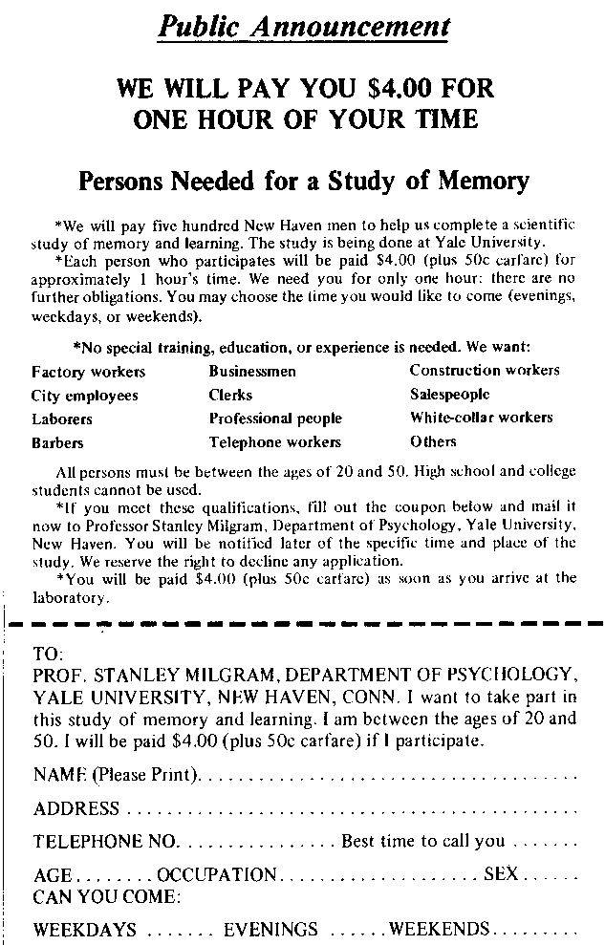

For example, Milgram Study (1961-1963)
On the left is an ad for a study of Memory.
(https://youtu.be/Kzd6Ew3TraA)
https://en.wikipedia.org/wiki/Milgram_experiment
Notes:
9

Slide 10
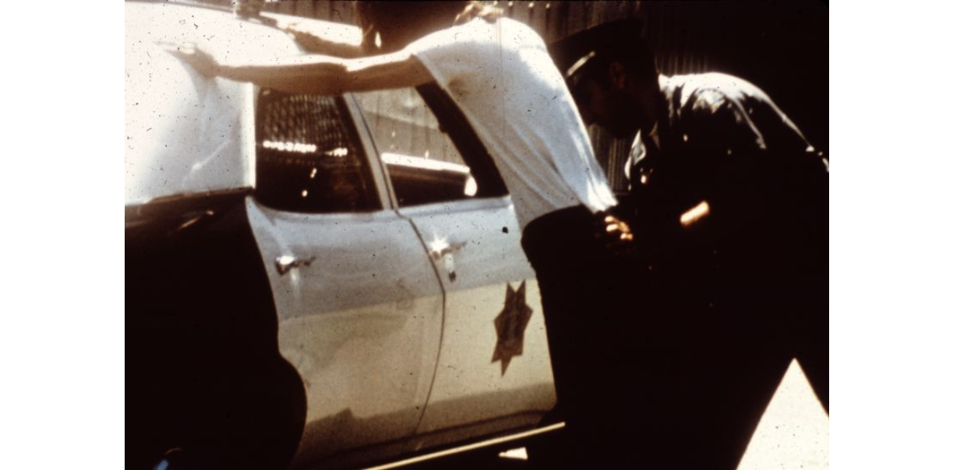
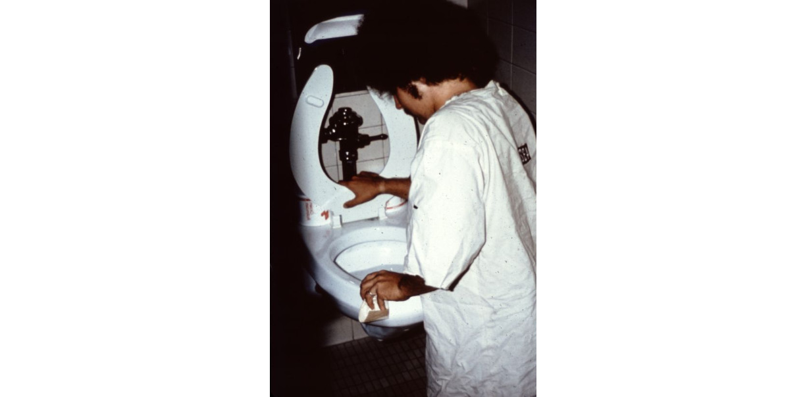
For example, Stanford Prison Experiment (1971)
https://exhibits.stanford.edu/spe/catalog/sk516df1347
Notes:
10

Slide 11
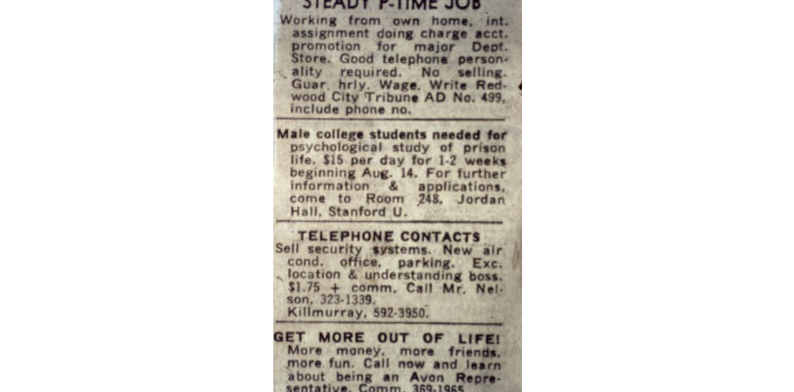

For example, Stanford Prison Experiment (1971)
On the right is an ad for a study of prison life.
The ad does not mention being screamed at, being arrested, being stripped nude, being chained, being locked a small closet for solitary confinement and being forced to clean toilets with your bare hands.
https://exhibits.stanford.edu/spe/catalog/sk516df1347
Notes:
11
Mention here the first concepts we need to look for:
voluntary participation
informed consent
transparency and deception

Slide 12

What are ethics?
Before reviewing a history of unethical behavior and experiments, and resulting changes, let’s first think about ethics?
What are ethics?
What does it mean to be — or act — ethically or unethical, generally speaking?
What does it mean to conduct an i) ethical or ii) unethical study with human participants?
Any ideas or thoughts?
Notes:
12
2 Breakout rooms | 5 minutes
Prompt the class, allow a discussion, let it flow freely, if possible:
What makes a person act ethical or unethical?
What makes a research study ethical or unethical?
If you act ethical — according to the societally, legally and culturally accepted standards and norms — you are acting and behaving in moral, fair and beneficial manner for you and others. Simply said, you are doing the right thing.
https://unsplash.com/photos/tVkdGtEe2C4

Slide 13

Toward ethical research practices and codes
A short and incomplete history
Notes:
13
2 Breakout rooms | 5 minutes
Prompt the class, allow a discussion, let it flow freely, if possible:
What makes a person act ethical or unethical?
What makes a research study ethical or unethical?
If you act ethical — according to the societally, legally and culturally accepted standards and norms — you are acting and behaving in moral, fair and beneficial manner for you and others. Simply said, you are doing the right thing.
https://twitter.com/us_fda/status/652205035129040896

Slide 14
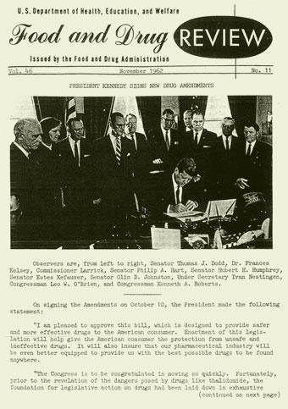
Toward ethical research practices and codes
A short and incomplete history
Nuremberg Code (1948)
Kefauver Amendments (1962)
Declaration of Helsinki (1964)
National Research Act (1974)
Belmont Report (1979)
The Common Rule (1981)
https://twitter.com/us_fda/status/652205035129040896
Notes:
14
Prompt the class, allow a discussion, let it flow freely, if possible:
What makes a person act ethical or unethical?
What makes a research study ethical or unethical?
If you act ethical — according to the societally, legally and culturally accepted standards and norms — you are acting and behaving in moral, fair and beneficial manner for you and others. Simply said, you are doing the right thing.
https://twitter.com/us_fda/status/652205035129040896

Slide 15
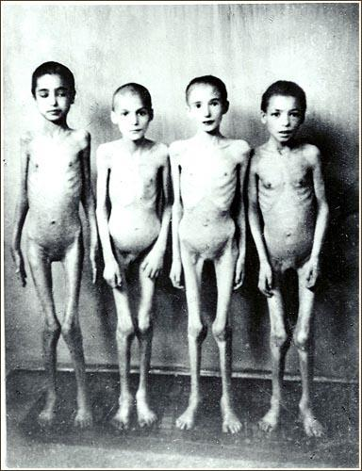
Nuremberg Code
Established 1948, as a result of German War Crimes and medical experiments in the 1930s-1940s
What happened:
Medical experiments on thousands of people without their consent
23 Germans tried for war crimes regarding unethical experiments, 16 were found guilty
https://www.dailymail.co.uk/news/article-2518619/Winter-camps-Holocaust-survivor-died-Auschwitz-worked-concentration-camps-aged-just-13-recalls-bitterest-months-Nazi-persecution.html
Notes:
15
One of the first examples of a series of unethical experiments were the pseudoscientific medical experiments utilizing thousands of concentration camp prisoners without their consent during World War II, conducted by German physicians.
Commonly later known as the “Doctor’s Trials”
https://encyclopedia.ushmm.org/content/en/article/the-doctors-trial-the-medical-case-of-the-subsequent-nuremberg-proceedings

Slide 16
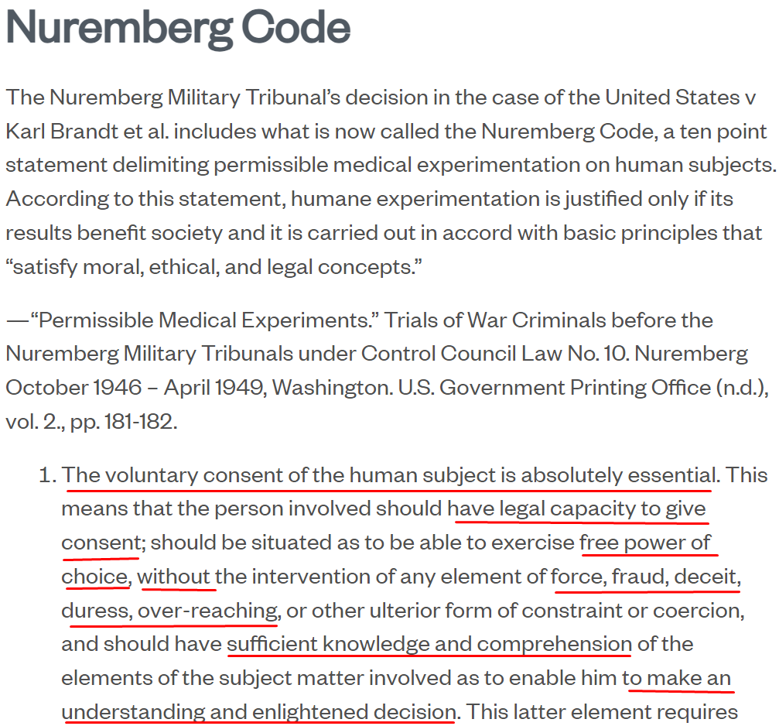
Nuremberg Code
Outcomes of the NC:
A ten point statement delimiting permissible medical experimentation on human subjects
Voluntary human subject consent is absolutely essential (voluntary participation and informed consent)
Notes:
16
The Nuremberg Trials resulted in the Nuremberg Code:
“humane experimentation is justified only if its results benefit society and it is carried out in accord with basic principles that “satisfy moral, ethical, and legal concepts.”
Leads to the concept of Beneficence
https://research.unc.edu/human-research-ethics/resources/ccm3_019064/

Slide 17
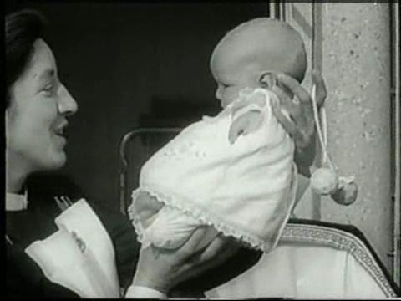
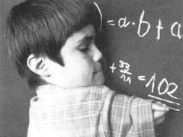
Kefauver Harris Amendments
Established 1962
Late 1950s pregnant women given thalidomide to reduce nausea and help with sleep
Patients did not know thalidomide was not FDA approved
Over 12,000 babies born with deformities
https://www.itv.com/news/calendar/2017-03-03/family-appeal-for-answers-over-thalidomide-baby-death https://theconversation.com/why-thalidomide-survivors-have-such-a-tough-time-getting-compensation-47164
Notes:
17
Kefauver Harris Amendments amend the Federal Food, Drug, and Cosmetic Act (first introduced in 1938).

Slide 18
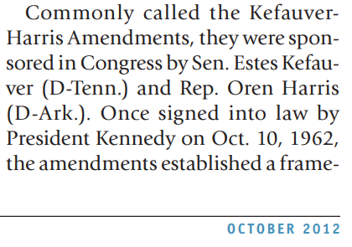
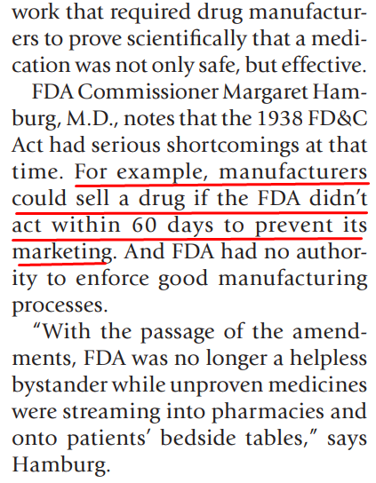
Kefauver Harris Amendments
Outcomes:
Studies must assess risks and benefits
Drug manufacturers must prove to FDA the effectiveness before marketing
Introduced "proof-of-efficacy” standard for drugs
Notes:
18
Kefauver Harris Amendments amend the Federal Food, Drug, and Cosmetic Act (first introduced in 1938).

Slide 19
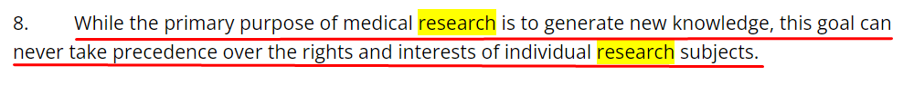
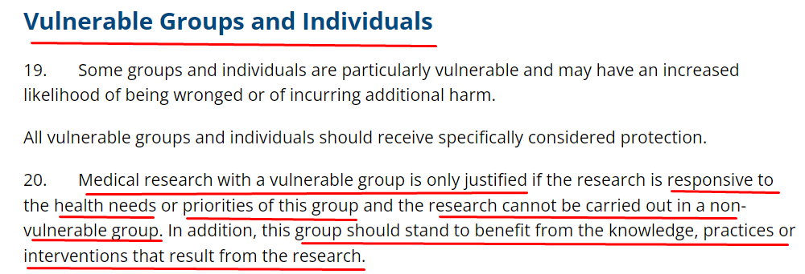
Declaration of Helsinki
Established 1964
Was iterated on since WWII
Outcomes:
Participants can only give consent once they are fully informed;
prioritize participant health;
be aware of “special populations”, indigenous or vulnerable populations (prisoners).
Notes:
19
Is not legally binding and is/was revised multiple times from 1975-2013.
The latest revision from 2013, e.g., introduces a “includes a requirement for medical care and financial compensation for suffered injuries, related to research
https://www.wma.net/policies-post/wma-declaration-of-helsinki-ethical-principles-for-medical-research-involving-human-subjects/

Slide 20

Example: Tuskegee Syphilis study
Belmont Report and IRB Creation
National Research Act (1974) & Belmont Report (1979) led foundation for Institutional Review Board (IRBs)
Based on review of the Tuskegee Syphilis study, an unethical experiment conducted by the US Government from 1932 — 1972
Notes:
20
IRB created through the Research Act of 1974
Participants were not informed about the disease, just about incentives (free care, free hot meal, and $35/$50 in the event of death)

Slide 21
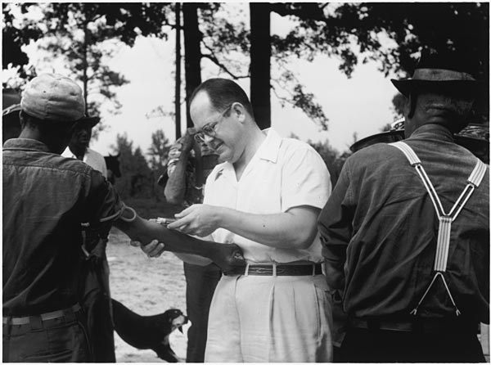
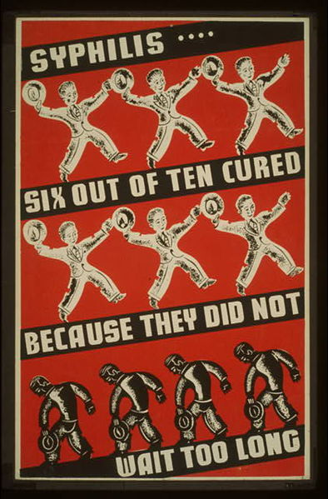
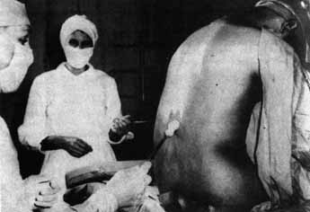
Example: Tuskegee Syphilis study
Belmont Report and IRB Creation
The goal was to “observe the natural history of untreated syphilis” in black populations, but the subjects were completely unaware and were instead told they were receiving treatment for bad blood when in fact, they received no treatment at all.
https://www.mcgill.ca/oss/article/history/40-years-human-experimentation-america-tuskegee-study
Tuskegee Syphilis study
In 1932, 400 black, poor, low literacy sharecroppers had syphilis
In 1947 penicillin was invented… participants were not offered it
Study was not stopped until 1973!
https://www.mcgill.ca/oss/article/history/40-years-human-experimentation-america-tuskegee-study https://www.joshuakennon.com/the-tuskegee-experiment/
https://commons.wikimedia.org/wiki/File:Syphilis-poster-wpa-cure.jpg
Notes:
21
IRB created through the Research Act of 1974
Participants were not informed about the disease, just about incentives (free care, free hot meal, and $35/$50 in the event of death)

Slide 22
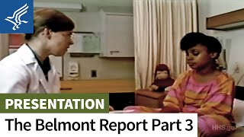
Belmont Report and IRB Creation
National Research Act (1974) & Belmont Report (1979) led foundation for Institutional Review Board (IRBs)
Outcomes:
Informed consent;
Independent review;
Risks should not exceed benefits;
Protect human subjects
Notes:
22
IRB created through the Research Act of 1974
Participants were not informed about the disease, just about incentives (free care, free hot meal, and $35/$50 in the event of death)

Slide 23
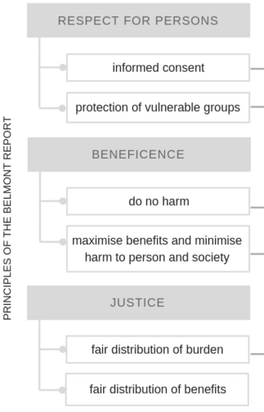

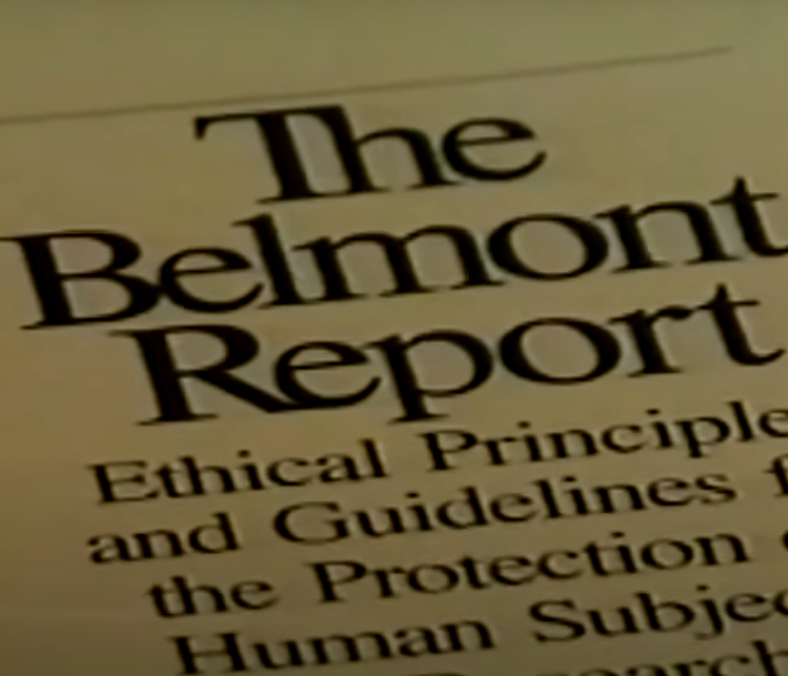
Ethical Considerations from the Belmont Report
Anabo, I.F., Elexpuru-Albizuri, I. & Villardón-Gallego, L. Revisiting the Belmont Report’s ethical principles in internet-mediated research: perspectives from disciplinary associations in the social sciences. Ethics Inf Technol 21, 137–149 (2019). https://doi.org/10.1007/s10676-018-9495-z
Notes:
23
Updated over the years to Informed Consent - Nuremburg Code from the Nazi medical experiments on unsuspecting people
Assessment of risks and benefits - Thalidomide - given to pregnant women without FDA approval and resulted in over 12,000 babies with birth defects.
Beneficence - Tuskegee Syphilis Study - 1932 to 1972 - 40 YEARS! The US Public Health Services injected low income African Americans with syphilis to study the effects. Subjects were not told about their disease and when the subjects went to other doctors, researchers stepped in to ensure subjects would not receive care. Even worse - the cure for syphilis - penicillin was discovered in the 50s!!! - This brought on the National Research Act of 1974 that works to ensure ethics in medical research.
Justice - Declaration of Helsinki (1964) medical research should be reviewed by an independent counsel.

Slide 24
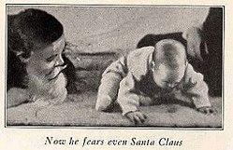
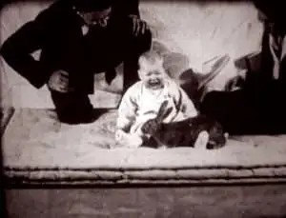
The Common Rule
Iterating on Belmont Report
Special considerations for pregnant people (1978) and prisoners (1978)
More reports and considerations for…
… people developing nations (1982)
… children (1983), and
… people with mental health considerations (1999)
https://images.newscientist.com/wp-content/uploads/2014/10/dn26307-1_300.jpg
https://upload.wikimedia.org/wikipedia/commons/c/cc/Little-albert.jpg
Notes:
Little albert (1920) experiment: a controversial experiment on human conditioning of a child.
The Common Rule is a 1981 rule of ethics in the United States regarding biomedical and behavioral research involving human subjects.
The Common Rule includes additional protections for certain vulnerable research subjects
https://en.wikipedia.org/wiki/Common_Rule#:~:text=The%20Common%20Rule%20is%20the,of%20rights%20regardless%20of%20funding.
24

Slide 25
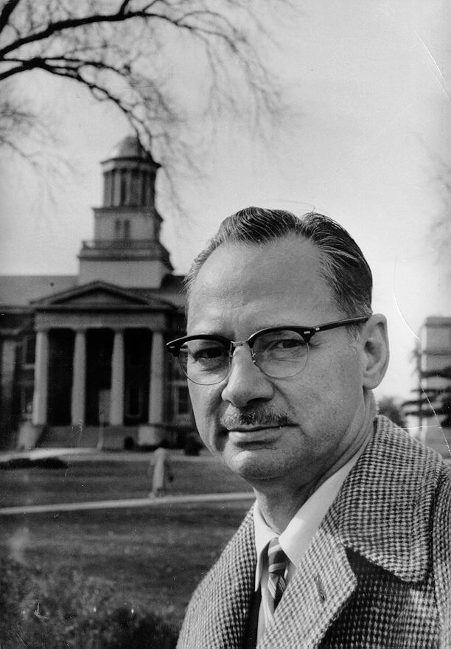

Example: Monster Study
A stuttering / reinforcement experiment on 22 orphan children at the University of Iowa.
1939: Conducted by Wendell Johnson, lasting about 6 months
2001: University of Iowa apologizes
2007: 7 orphan children were awarded $1.2M US Dollar “by the State of Iowa for lifelong psychological and emotional scars caused by six months of torment during the University of Iowa experiment.” https://en.wikipedia.org/wiki/Monster_Study#cite_note-2
Notes:
25
Milgram Study: An example of deception: A study of memory, but it was a study of obedience.
Stanford Prison Study: The study of evil
Monster Study: “Half of the children received positive speech therapy, praising the fluency of their speech, and the other half, negative speech therapy, belittling the children for speech imperfections. Many of the normal speaking orphan children who received negative therapy in the experiment suffered negative psychological effects, and some retained speech problems for the rest of their lives.”
https://en.wikipedia.org/wiki/Monster_Study

Slide 26

Applied Ethics in HCI
Using Ethics in I300, Design Research and Professional Contexts
… this is a class about UX Design and Human-computer Interaction…
… why are ethics important for our work?
… why do we need to talk about ethics in this class?
Notes:
26
Prompt the class, allow a discussion, let it flow freely, if possible:
What do ethics have to do with human-computer interaction, with design, with UX?
You will be working with people…collecting data…reporting on data etc.
That means…we conduct tests, field studies, interviews and observations with real users, children, adults, parents, etc.

Slide 27
Applied Ethics in HCI
In course, in other research contexts as well as in professional settings
Remember, we work with People in HCI/d
Full Disclosure
Anonymity & Confidentiality
Informed Consent
Voluntary Participation & Early Termination
Incentives upon Completion
Notes:
27
https://unsplash.com/photos/MYwtNqVjC7o

Slide 28
Applied Ethics in HCI
1. Remember, we work with People in HCI/d
For your research(Interviews, Observations, User Tests), keep the following guidelines in mind.
Notes:
28
https://unsplash.com/photos/MYwtNqVjC7o

Slide 29
Applied Ethics in HCI
2. Full Disclosure
Explain to your participants what is going to happen before the study, for instance, if you want to record them, ask them if that is ok or not.
Notes:
29
https://unsplash.com/photos/MYwtNqVjC7o

Slide 30
Applied Ethics in HCI
3. Anonymity & Confidentiality
Is data anonymized or if not, is personally identifiable information kept confidential. Who has access to it? How will it be shared?
Notes:
30
https://unsplash.com/photos/MYwtNqVjC7o

Slide 31
Applied Ethics in HCI
4. Informed Consent
Ask your participants if they have any questions or concerns before the study.
If they do, address them.
Notes:
31
https://unsplash.com/photos/MYwtNqVjC7o

Slide 32
Applied Ethics in HCI
5. Voluntary Participation & Early Termination
Make it clear to your participants that they can ask questions, take a break, or even end the study at any time, if they want to.
Notes:
32
https://unsplash.com/photos/MYwtNqVjC7o

Slide 33
Applied Ethics in HCI
6. Incentives upon Completion
If you offer compensation, you may consider the actual payout based on the participant’s study completion.
Notes:
33
https://unsplash.com/photos/MYwtNqVjC7o

